Slide 1
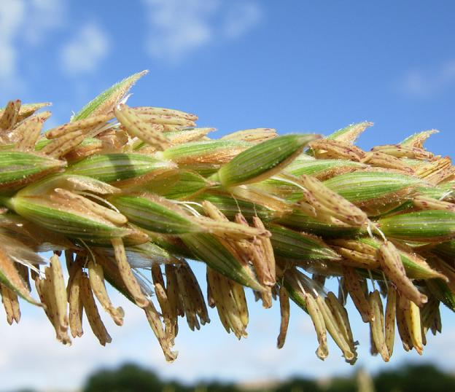

Maize anthers
Virginia Walbot
Biology Department
Stanford University
walbot@stanford.edu

Slide 2
Why study anthers?
Organ where somatic cells acquire meiotic competence and mature into pollen.
Control of pollination is essential for the multi-billion $ hybrid seed industry and determines gene flow in natural populations.
100X more male-sterile than female-sterile mutants.
Pollen production is the most environmentally sensitive plant life stage.

Slide 3
Why study anthers?
Anthers express the most genes of any plant organ.
No meristem – expect distinct developmental mechanisms for de novo acquisition of cell fate.
One third of the annual plant lifecycle is required to build an anther and pollen.
Vegetative
Anther
Seed

Slide 4
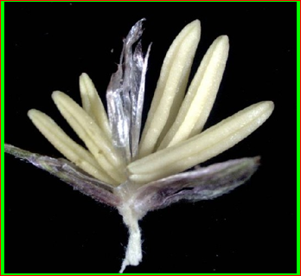
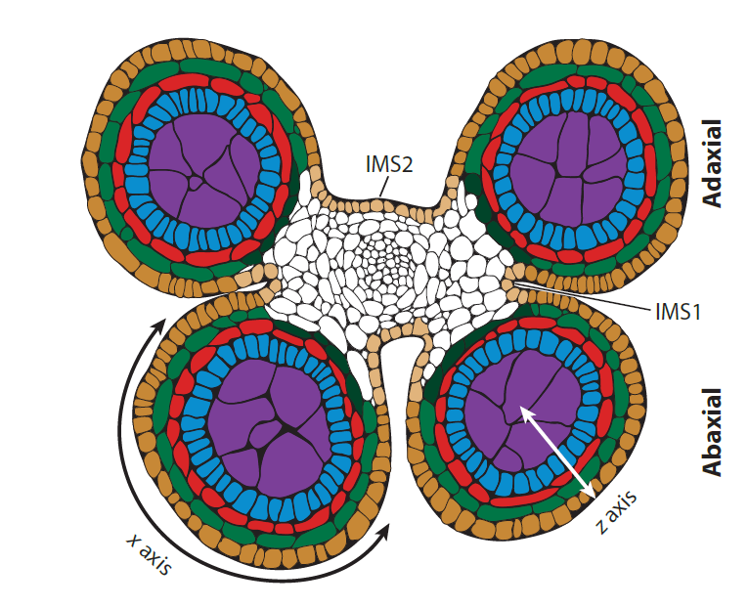
Epidermis
Vascular & Connective
Endothecium
Middle Layer
Tapetum
Archespore -> Meiocyte -> Gametophyte -> Pollen

Slide 5
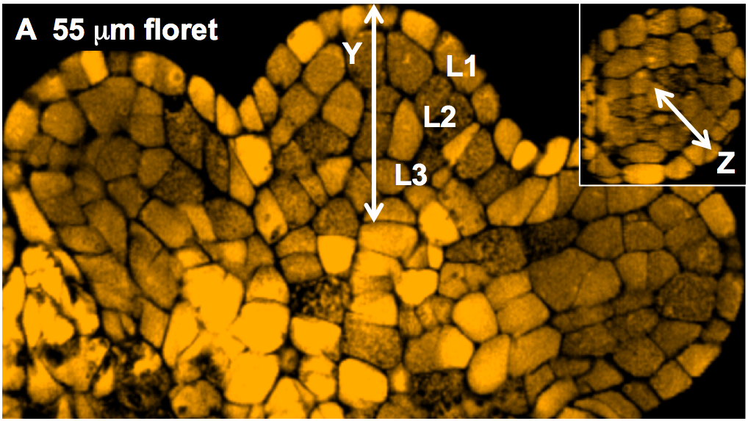
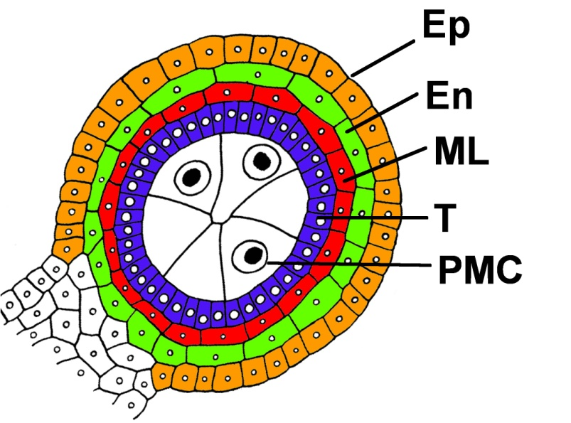
Building an anther: rapid cell proliferation and fate setting.
9 days later meiosis starts in the 1.2 mm anther with 50,000 cells in four lobes each with a dartboard architecture of 5 tissues each composed of one cell type.
L2
Floret meristem makes 3 stamen initials, using up the meristem. Anther primordia of ~100 Layer1 and Layer2 cells form at the stamen tips.

Slide 6
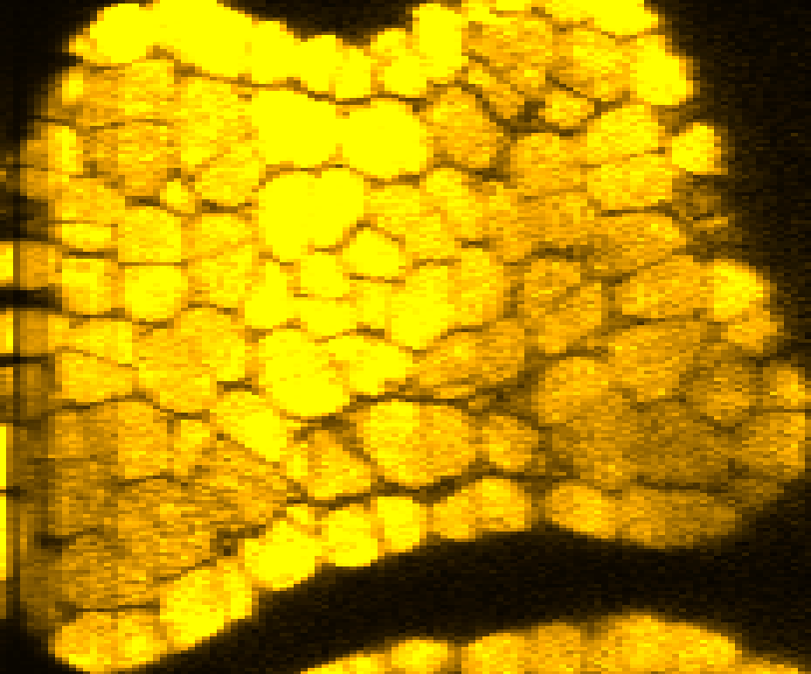
The LINEAGE MODEL … where we started ….
Asymmetric division of a hypothesized giant lobe cell?
?
Confocal analysis
Four real lobes have multiple same size L2-derived cells of diverse cell shapes with similar 3D volumes at ~115 µm.

Slide 7
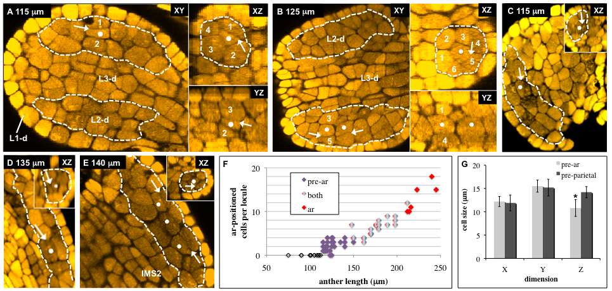
L2 remain similar until some L2 have only L2 neighbors (dot). Then dependent on MSCA1 glutaredoxin, these cells enlarge as pre-Archesporial Cells (AR).
No physically asymmetric cell division makes a giant cell: enlargement is after specification. About 10 – 12 AR cells are specified in a column within each lobe: some pre-AR are being born as older pre-AR enlarge to AR over a 24 hour period and neighbor cells divide periclinally.
Pre vt
Pre vt
Kelliher & Walbot. 2011 Developmental Biology

Slide 8
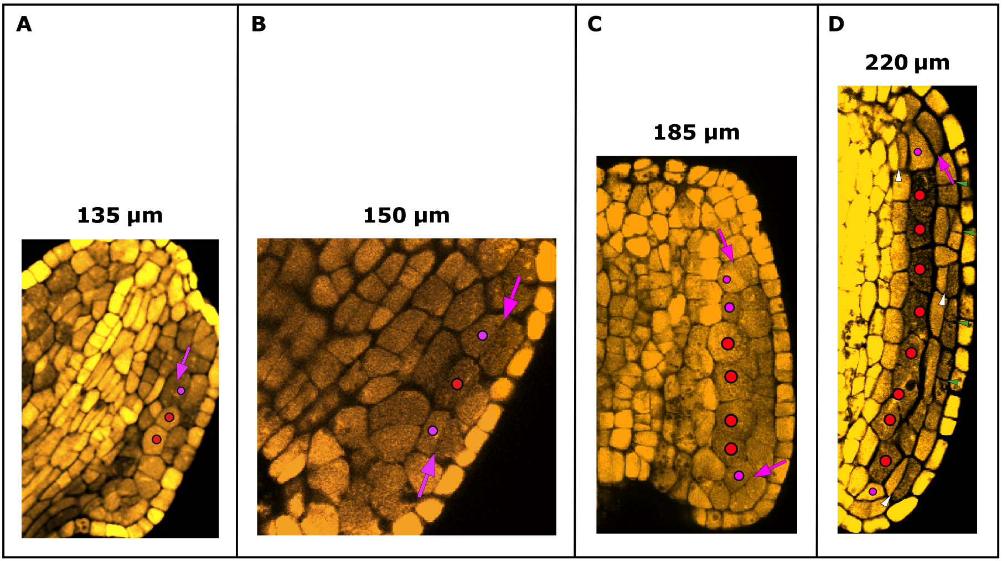

Archesporial column of ~10 - 12 cells is generated
MSCA1, a glutaredoxin, is required
Enlargement after specification
AR secrete MAC1 => periclinal division in L2-d
Kelliher & Walbot Dev. Biol. 2011

Slide 9
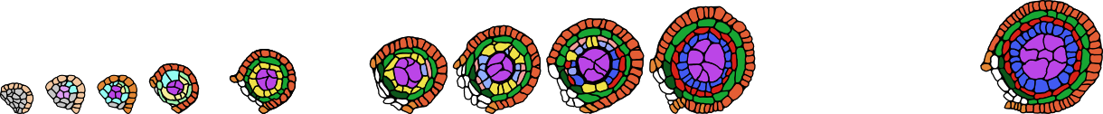

MSCA1 dependent step =>
AR secrete MAC1 => neighbor L2-d acquire somatic fate as PPC stem cells
PPC => SPL and EN SPL => Middle Layer
& Tapetum
L1-d L2-d
L1-d
L2-d
Archesporial specified
PPC
Epidermis specified
SPL specified
Endothecium specified
Lineage Model is Dead – Dynamic Origin of Cell Types

Slide 10

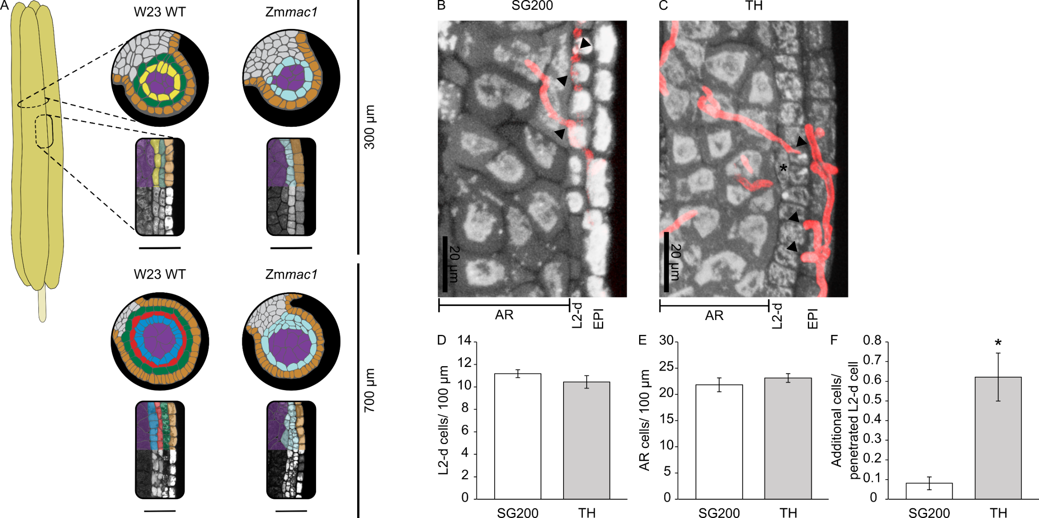
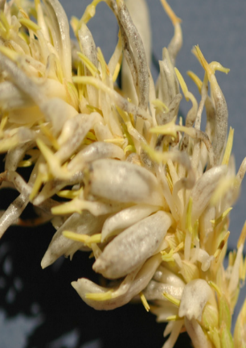
Trojan horse proof Ustilago maydis secreting MAC1 cause mutant mac1 L2 cells to divide periclinally.
MAC1
van der Linde et al. 2018. Plant Cell
Score L2-d periclinal divisions 2 days later.
Skibbe et al.

Slide 11
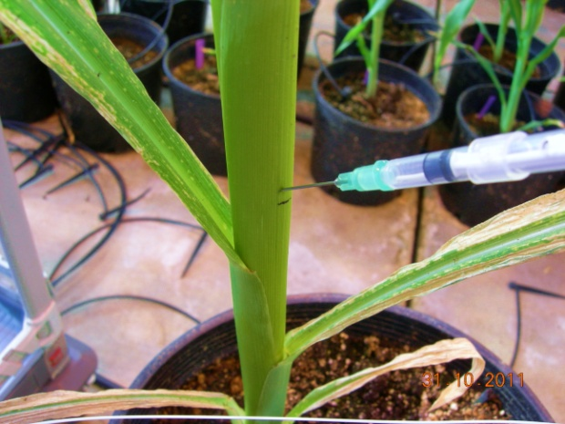
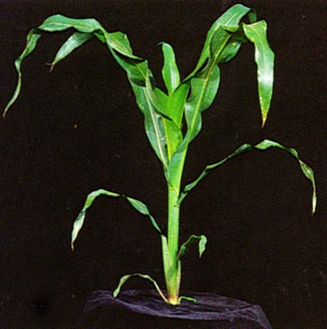
What triggers AR specification to start events? Glutaredoxin MSCA1 is a clue.
Tassel is hypoxic during AR specification!
O₂ measurement around tassel
Ambient air = 20%
16%
11 %
4 %
1.4 % at tassel (2 cm stage)
The condition is transient –
3 days later O₂ is 5% or greater
Kelliher & Walbot Science 2012
tassel
Notes:
Made us start to think outside of the developmental box – into the physiology of redox. Just what would be happening here?
Anthers are a big sink… encased in a whorl of non photosynthetic leaves… we reasoned there is high metabolic demand and that ... O2 would be depleted in the airspace between the tassel and the first leaf of the whorl surrounding the tassel.
So we obtained an oxygen probe borne in a needle that we could position into the whorl alongside the developing tassel … as you go down from ambient air it decreases until its only 1.4 % at the tassel. Condition is transient during AR fate specification period, later O2 was 5%
What else exists in hypoxic state? Isn’t that bad for the cells? Stem cell niches in animals are hypoxic… allows them to proliferate more and keep them pluripotent while O2 seems to effect differentiation. Roots this is true too (H2O2)

Slide 12
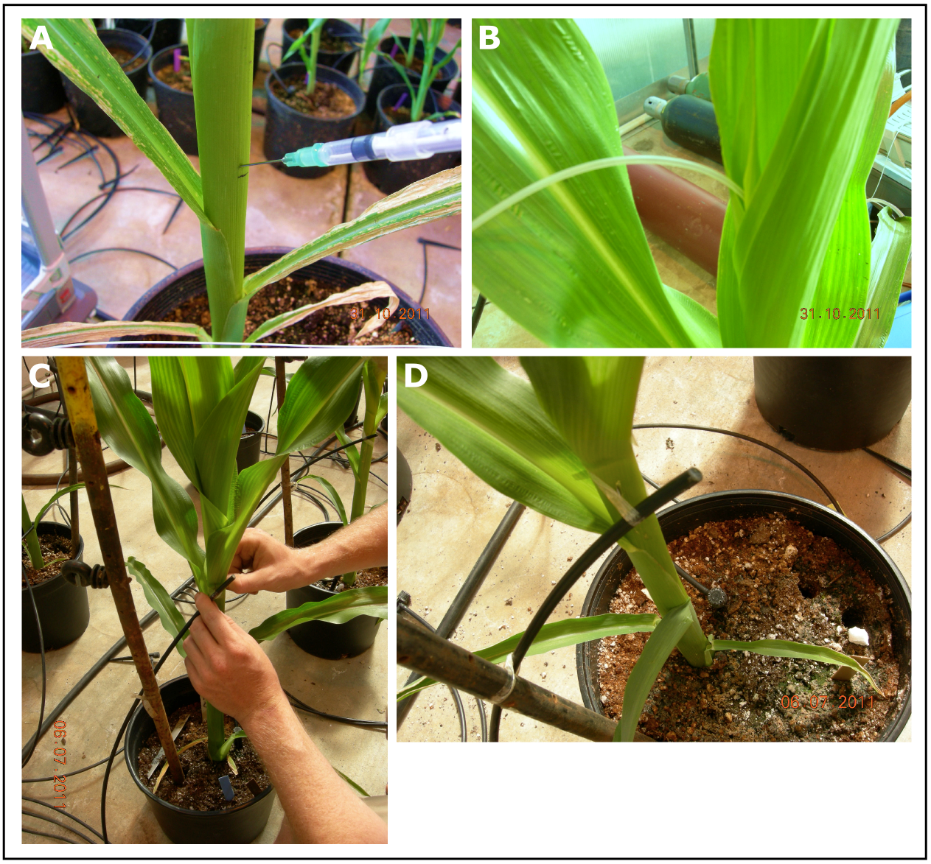
Hypothesize HYPOXIA, then prove by an experiment.
Hose inserted
into whorl, connected
to N₂ or O₂ tank
Needle delivery directly to the airspace
Treatments modify O₂ levels.
O₂ hose → >30 % at tassel.
N₂ hose → 0 % at tassel.

Slide 13
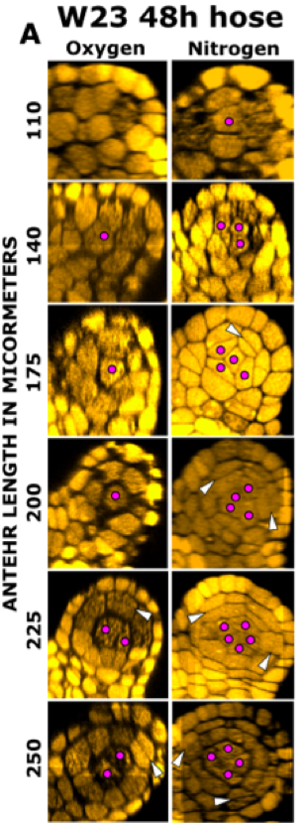
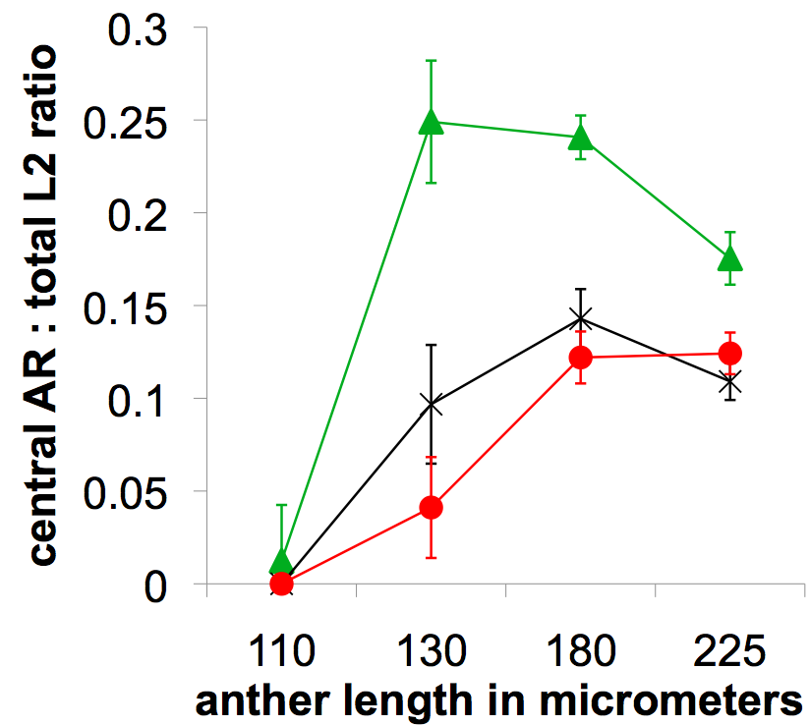
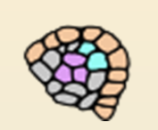


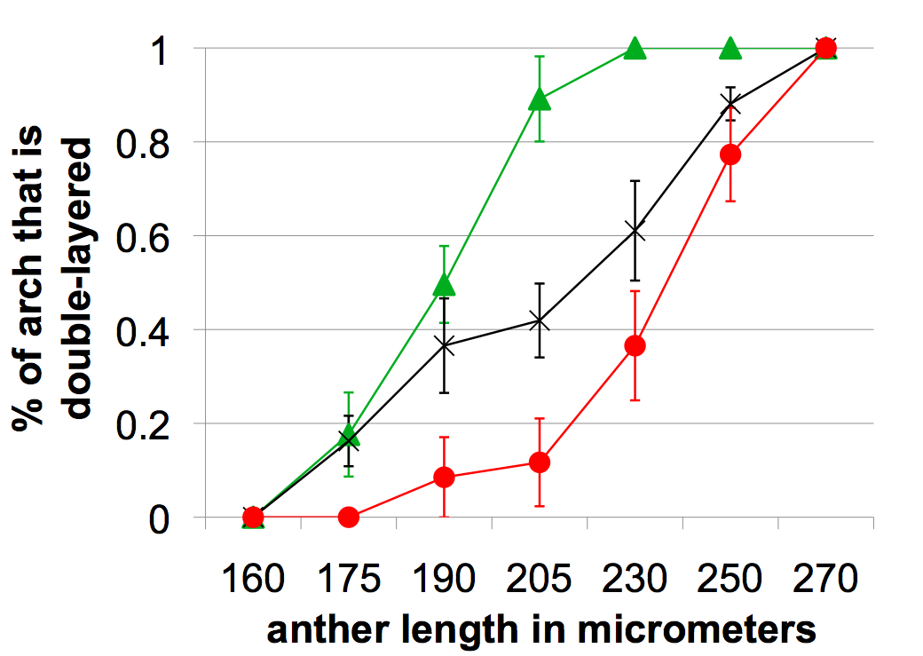
N₂ dramatically promotes AR specification and L2 periclinal division. O₂ slightly inhibits both events. Chemicals that alter redox work equally well.
AR number
Final AR:total ratio is normal
Periclinal ÷
but final cell composition
is normal

Slide 14
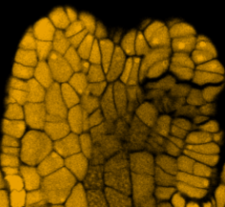
Reducing states rescue AR specification in msca1 mutants …confirming that redox controls AR fate.
Likely mechanism: TGA transcription factors reduced and thereby activated and move to the nucleus.
Surprise: Ectopic AR cells form during redox manipulation and organize periclinal divisions in novel locations…all cells are competent to respond to hypoxia and secrete MAC1.
132 μm N₂ needle

Slide 15
New insights about anther cell fate specification
AR do not arise from a physically asymmetric division of a “special” hypodermal cell refuting the classic lineage model.
Any anther cell could become a pre-meiotic AR. Particularly striking that pre-epidermis and pre-vascular cells can differentiate as AR during hypoxia. All anther cells contain MSCA1 and can respond.
AR arise first and then up-regulate and secrete MAC1 to organize the soma, opposite of animals.
Hypoxia may be a general trigger, an emergent property of growth (solves the “am I a large enough organ mass to differentiate question”).

Slide 16
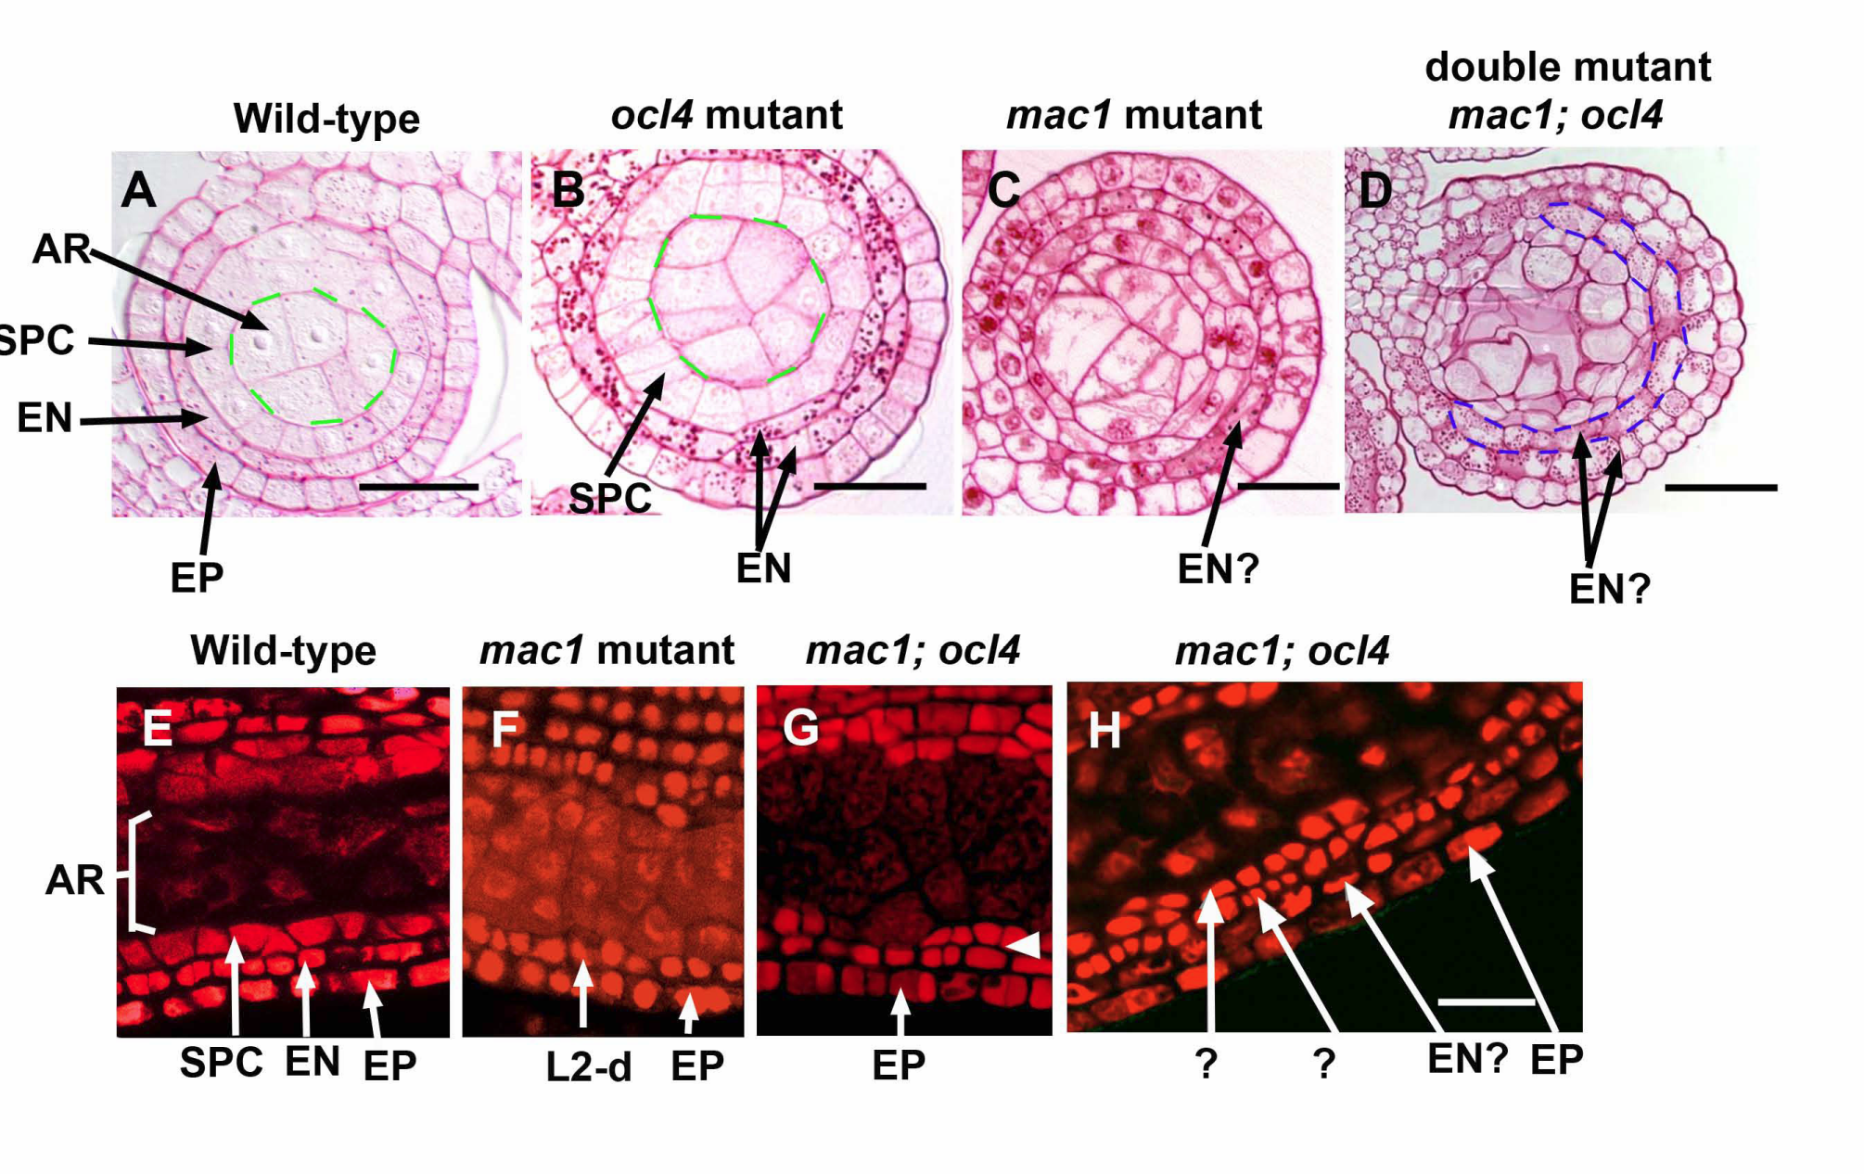
OCL4 epidermal cells send a signal that suppresses extra subepidermal (EN) periclinal divisions, fixing PPC fate. L2 cells in mac1 still respond to this negative signal as shown by double mutant analysis = separate signaling pathways.
PPC cells then make an unknown signal that suppresses extra cell divisions by the archesporial cells.
L2-d double layer
L2-d
L2-d
Wang et al. 2012. Development.

Slide 17

Epidermal OCL4 controls production of 21-nt phasiRNAs, which accumulate throughout the soma …. the mobile signal to trigger L2 somatic differentiation?

Slide 18
phasiRNAs – where, what, why?
Non-coding transcripts
from Pol II
430 21-PHAS loci
170 24-PHAS loci
m⁷G
cap
(A)_{n}
m⁷G
cap
(A)_{n}
Long-noncoding RNA
Many similarities to pre-meiotic mammalian piRNAs
Few if any mRNA targets
Very abundant
If missing, male sterility
Functions???
Long-noncoding RNA
miRNA guided cleavage
m⁷G
cap
(A)_{n}
m⁷G
cap
Precursors are ribosome-protected and most contain short ORFs; processing is cytoplasmic.
miR2275
(A)_{n}
AGO
miR2118
AGO
RDR6 synthesizes the
reverse strand
(A)_{n}
5’ degradation
(A)_{n}
5’ degradation
RDR6
RDR6
DICER-like cleaves precisely to make phasiRNAs
DCL4
DCL5
AGO5c
AGO?
biogenesis similar to transacting silencing RNA
21 nt phasiRNAs
24 nt phasiRNAs
Notes:
As for the 24-mers, we proposed that the binding partner of 24-phasiRNAs is AGO18. This is based on the expression pattern that

Slide 19
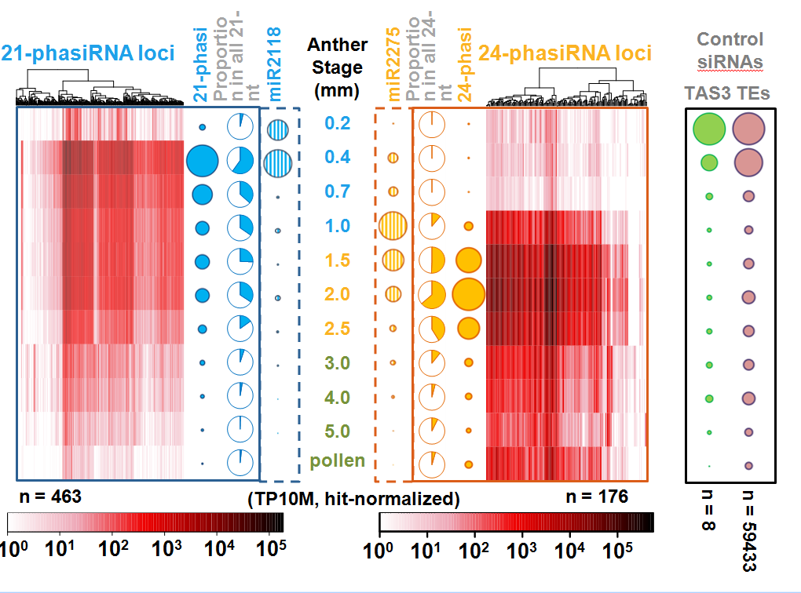
Temporal BIG BANG of 21-nt phasiRNAs
= somatic cell fate setting period
2009 discovery with Sundaresan & Vance
2014 – present Blake Meyers phasiRNAs in anther development
Zhai, Zhang, et al. 2015 PNAS

Slide 20
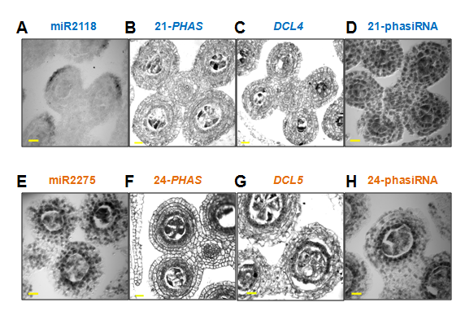
EPIDERMAL OCL4
21-nt phasiRNAs move throughout the lobe and are required for somatic fate
TAPETUM
MS23 MS32 bHLH122
24-nt phasiRNAs move to meiocytes and impact pace of tapetal differentiation
Zhai, Zhang, et al. 2015 PNAS

Slide 21
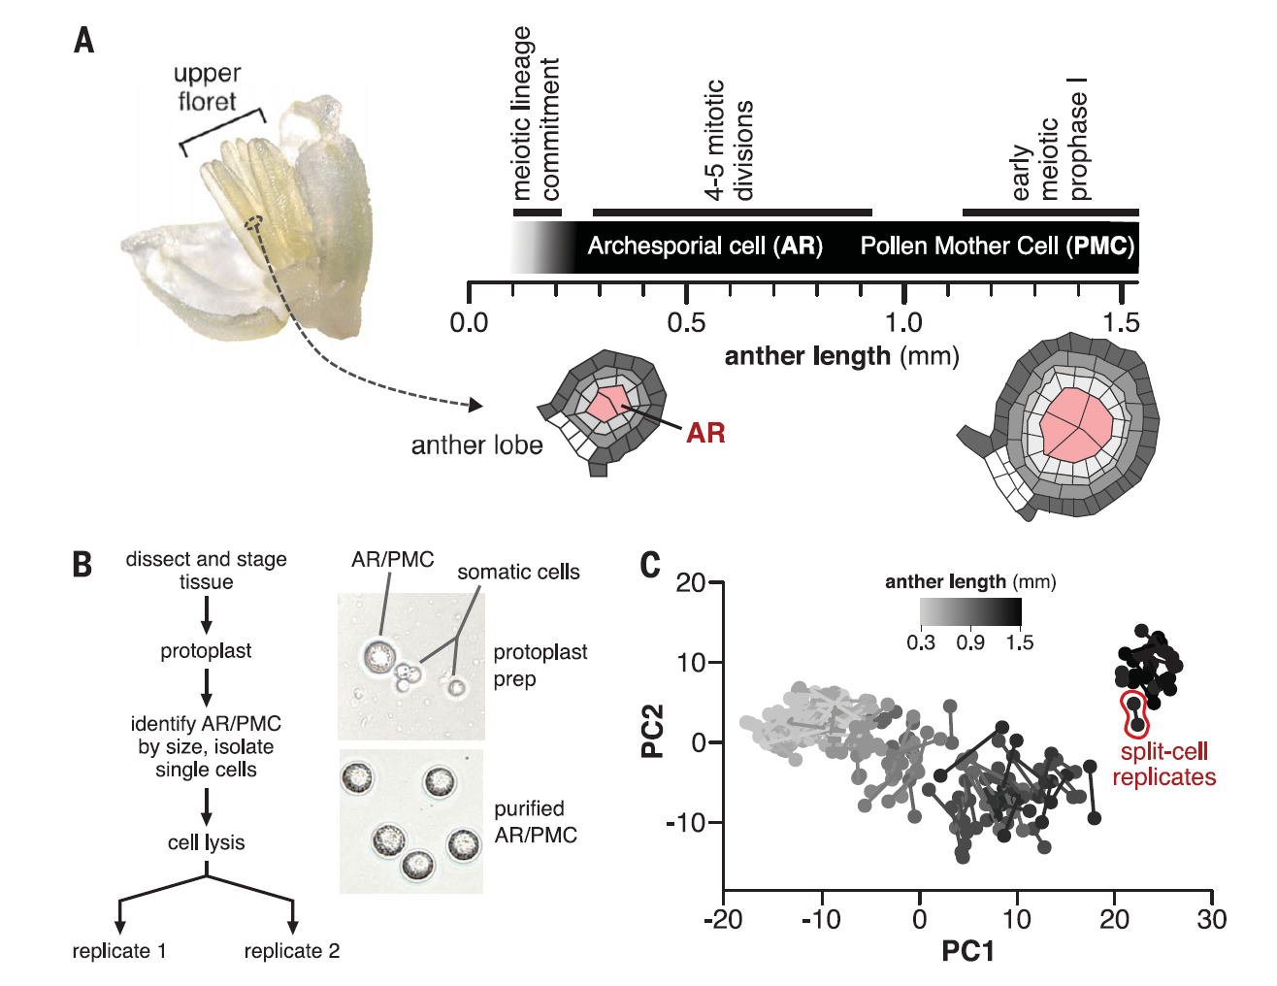
AR, PMC, and meiocytes enough RNA to permit split sample innovation to determine if biases occur during CellSeq2 library construction from a single cell.
144 cells
Nelms & Walbot 2019
Science

Slide 22
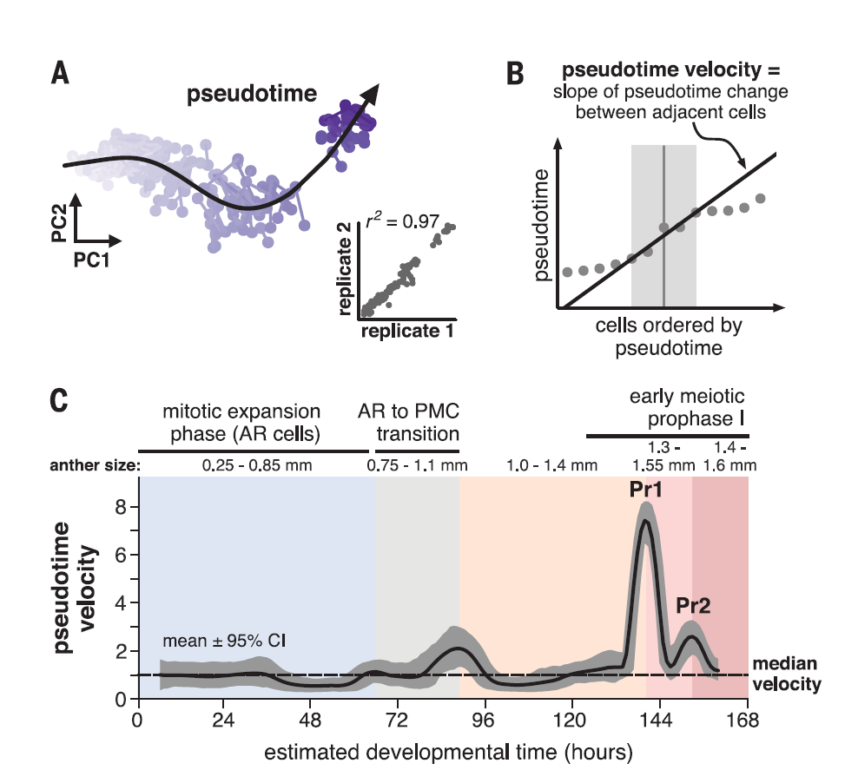
Pseudotime velocity, our new analytical tool, graphs rate of change with confidence intervals (CI).
Rapid transcriptome changes
AR to PMC transition
Leptotene Pr1
Leptotene/Zygotene Pr2

Slide 23
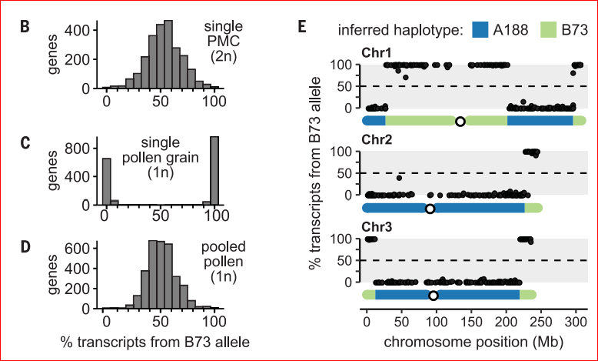
When does gametophytic transcription start?
Cross inbred A188 x B73 to get F1 hybrids for scRNA-seq.
Pre-meiotic: equal parental
One pollen: monoallelic expression of linked genes
Pooled pollen: equal

Slide 24
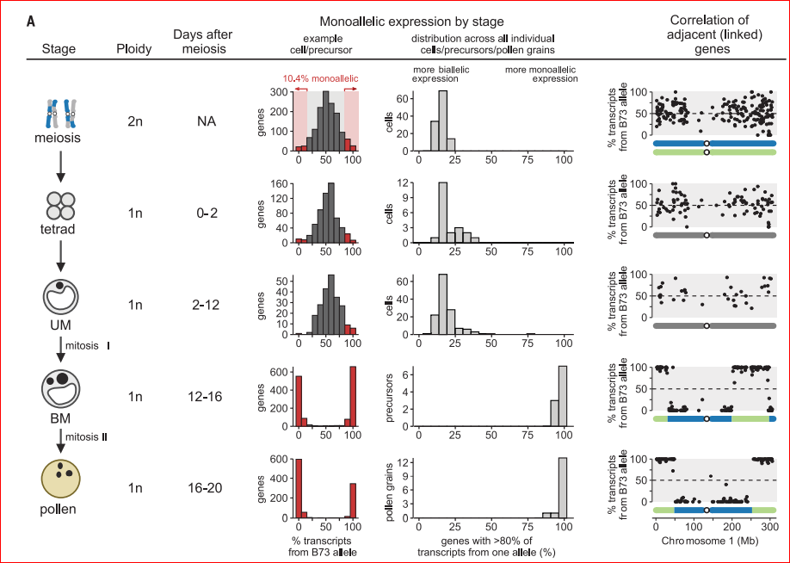
Assumption:
Gametophytes express genes right after meiosis.
Mono-allelic at Pollen Mitosis 1, for the final 9 days of pollen biogenesis.

Slide 25
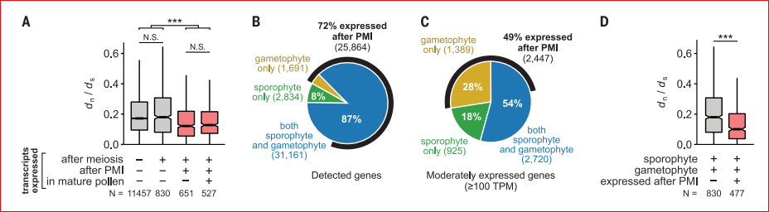
Alternation of generations reduces “genetic load” because most haploid-expressed genes are also expressed in the diploid sporophyte.
Genes expressed mono-allelically exhibit purifying selection: dn / ds non-synonymous/synonymous substitutions;
lower ratio indicates selection to retain an amino acid.
Nelms & Walbot 2022 Science

Slide 26
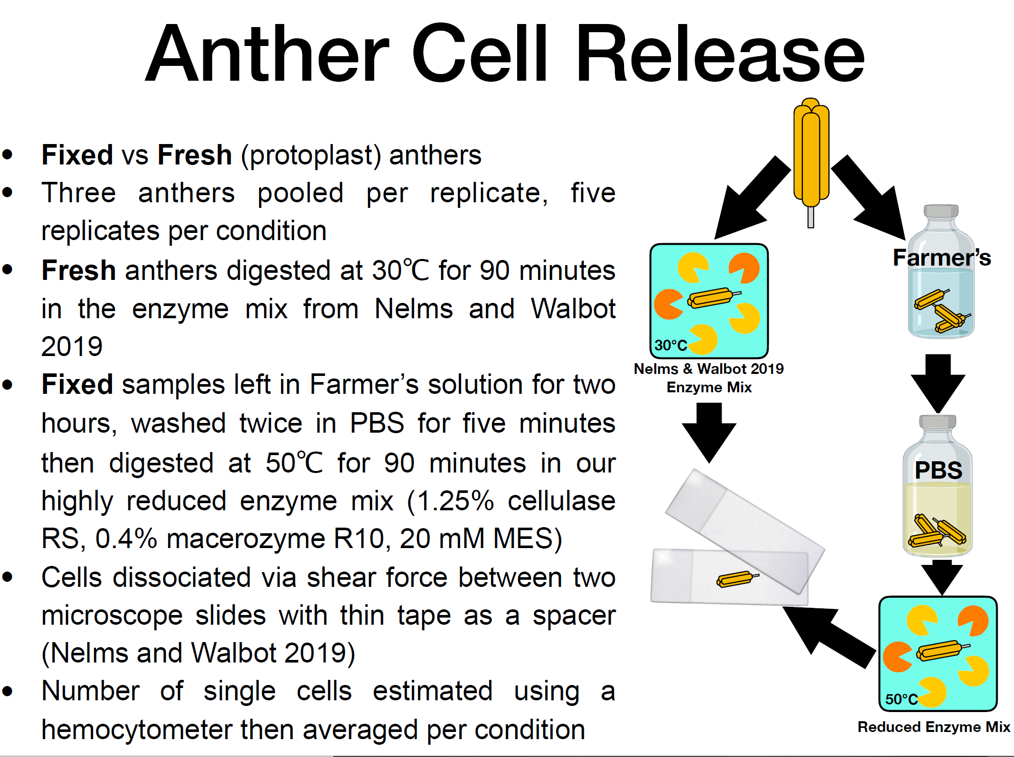
FX-CELL 5 to 10 minutes from tassel harvest -> anther dissection -> fixation 3 ethanol:1 acetic acid, then digest and process cells.
Germinal cells released by protoplasting and hand-picked.
~90 - 100 minutes to isolate a cell.
Marchant, Nelms, Walbot. 2022. BioRxiv. FX-CELL method

Slide 27
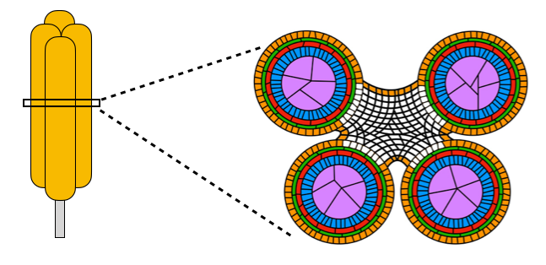
Anther cell composition & cell dimensions
Kelliher & Walbot 2011 Dev. Biology
Endothecium
Middle Layer
Tapetum
Epidermis
Meiocyte

Slide 28
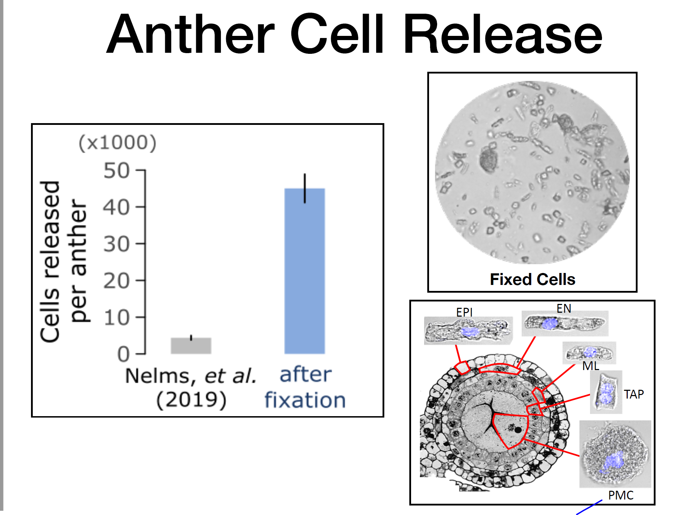
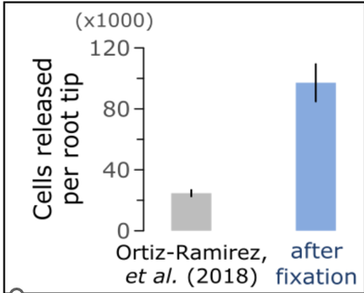
Maize root tip
2 mm anther has about 50,000 cells: we have 82 - 96% release, much higher than the 5% with fresh tissue.
All lobe cell types found in expected proportions, including vascular and connective cells. Representative!

Slide 29
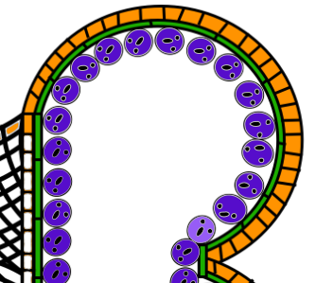
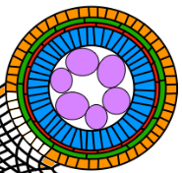
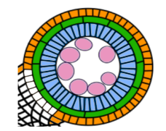
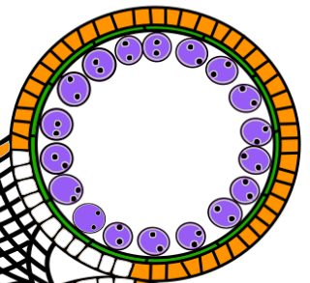
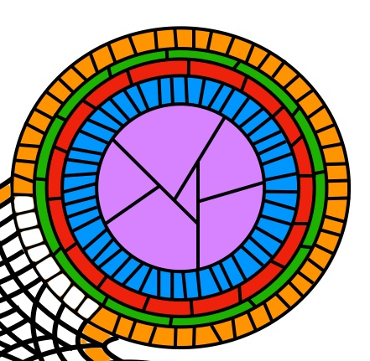

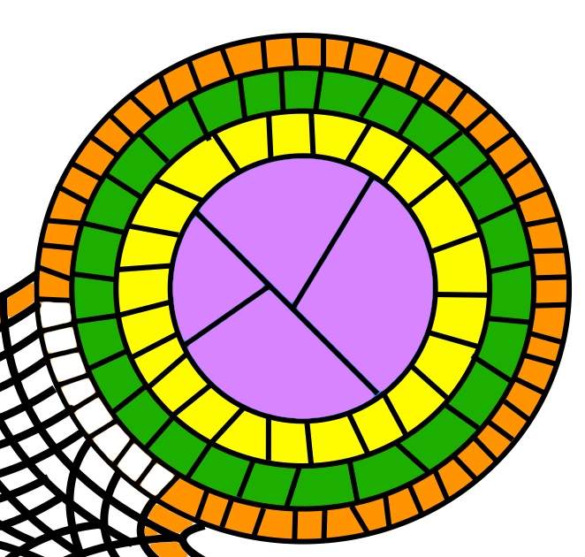
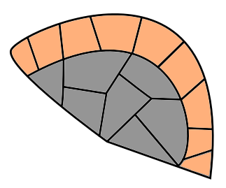
Trajectory of all cell types, sampling every 0. 25 mm
Layer 1
1 Parietal
Germinal
Epidermis
Tapetum
Layer 2
2 Parietal
Endothecium
Middle Layer
Connective/Vascular
Anther
Length (mm)
0
0.5
1.0
1.5
2.0
2.5
3.0
3.5
4.0
4.5
5.0
5.5
6.0
DAP
0
2
3
4
5
8
9
30
Cell Fate
Specification
Somatic
Differentiation
Meiosis
Pollen Maturation
Germinal Cell
Lineage
Archesporial
Cell
Pollen Mother
Cell
Uninucleate
Microspore
Bicellular
Microspore
Pollen
Somatic
Lineage
Uninucleate Tapetum
Binucleate Tapetum
L2
SPL
Middle Layer
PPC
Endothecium
L1
Epidermis

Slide 30
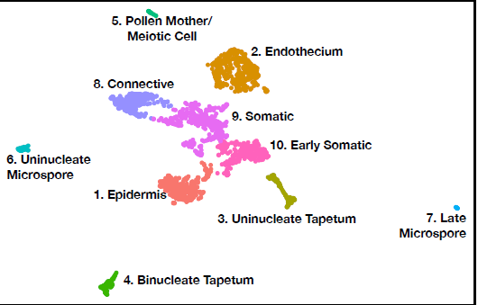
Marker genes for key cell types: endothecium has chloroplasts.
Pale early, dark later
Early Somatic: SPL, Middle
Layer, Immature Tapetum.

Slide 31
Temporal BIG BANG of 24nt phasiRNAs required for tapetal differentiation.
2009 discovery with Sundaresan & Vance
2014 – present Blake Meyers phasiRNAs in anther development sa
Zhai, Zhang, et al. 2015 PNAS

Slide 32
24-nt phasiRNAs – parallel to 21-nt class with novel factors
Non-coding transcripts
from Pol II
Many similarities to meiotic piRNAs
Few if any mRNA targets
Very abundant
If missing, male sterility
Functions???
170 24-PHAS loci
430 21-PHAS loci
m⁷G
cap
(A)_{n}
m⁷G
cap
(A)_{n}
Long-noncoding RNA
Long-noncoding RNA
miRNA guided cleavage
Ribosome-protected
m⁷G
cap
(A)_{n}
m⁷G
cap
miR2275
(A)_{n}
AGO
miR2118
AGO
RDR6 synthesizes the
reverse strand
(A)_{n}
5’ degradation
RDR6
(A)_{n}
5’ degradation
RDR6
DICER-like cleaves precisely to make phasiRNAs
DCL4
DCL5
AGO5c
AGO?
biogenesis similar to tasi RNA
21 nt phasiRNAs
24 nt phasiRNAs
Notes:
As for the 24-mers, we proposed that the binding partner of 24-phasiRNAs is AGO18. This is based on the expression pattern that

Slide 33
TAPETAL TFs
MS23 MS32 bHLH122
Program 24-nt phasiRNA expression in the tapetum.
24-nt phasiRNAs move
In meiocytes to silence PHAS loci via CHH methylation.
Control pace of tapetal differentiation.
Tapetal cells become binucleate during meiosis, with correct timing of this unique phenotype regulated by 24-nt phasiRNAs.
Zhai, Zhang, et al. 2015 PNAS

Slide 34
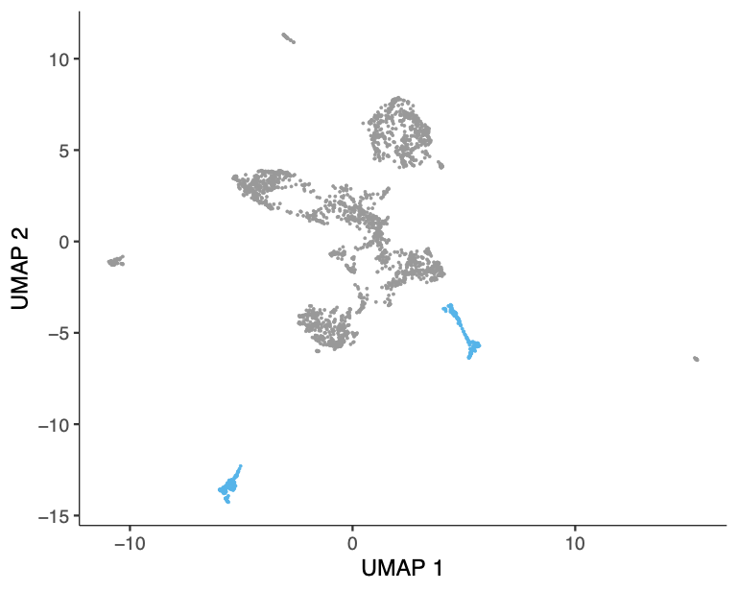
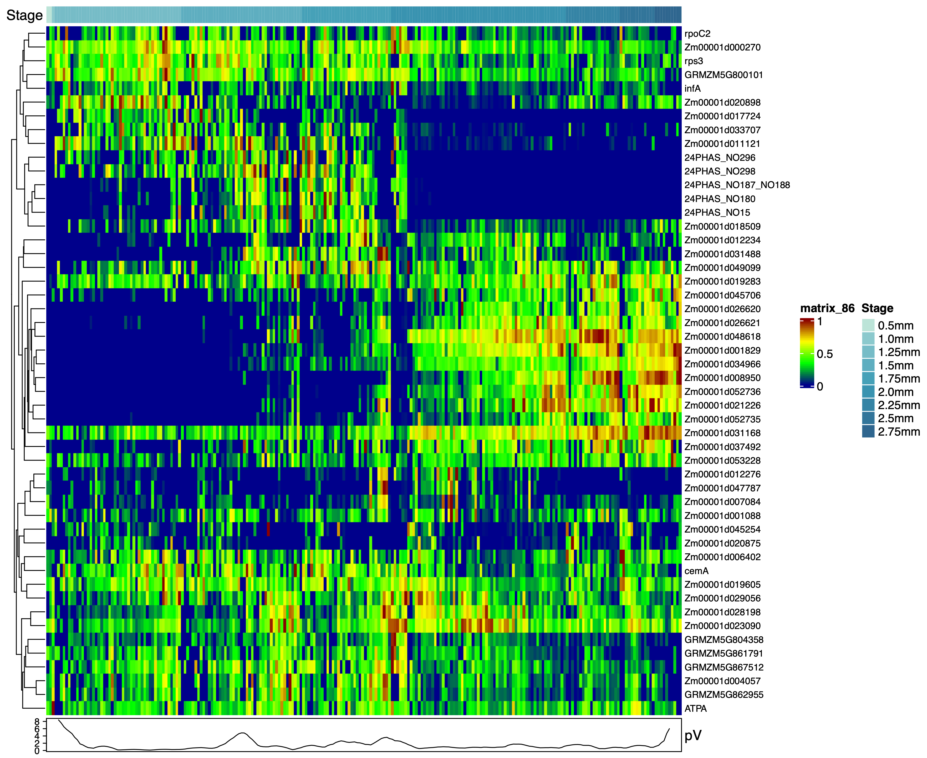
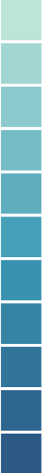
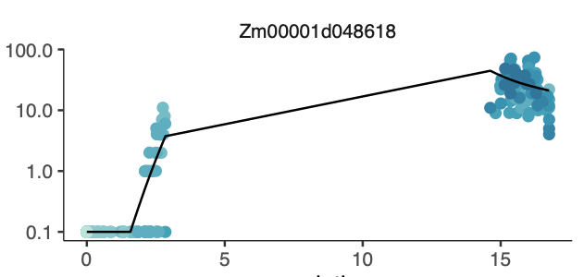
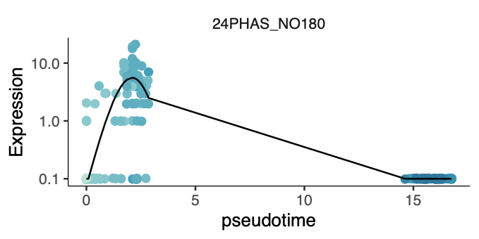
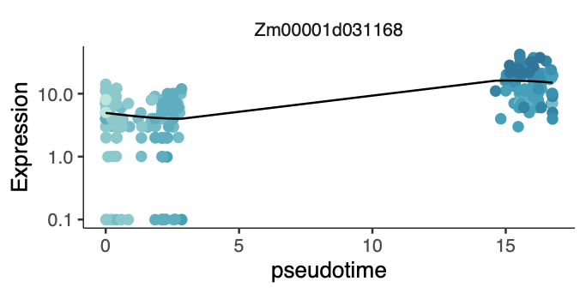
Tapetal cells sequentially differentiate for new roles.
Pseudotime
Velocity
Remodel PMC callose
Supply phasiRNA & nutrients to meiocytes
Lipophilic precursors for epidermal wax and endothecial plastids. 24 nt phasi RNAs.
Liberate tetrad microspores
Synthesize & secrete exine = secretory cell
PCD to form a “Velcro” pad for pollen
Gene
Anther Size
0.5 mm
0.75 mm
3. Uninucleate Tapetum
1.0 mm
UMAP2
1.25 mm
UMAP1
4. Binucleate Tapetum
1.5 mm
1.75 mm
2.0 mm
Expression
2.25 mm
50 most variable genes
2.5 mm
2.75 mm
Pseudotime
3.0 mm
Expression
Expression (TPM)
Max
Pseudotime
Glycine-rich Protein1
Min
Expression
Pseudotime
In progress, tapetal mutants to better define differentiation steps.

Slide 35


Scorecard
Origin of cells with pace and pattern of division on a timeline.
Functions of each cell type -- What goes awry in male-sterile mutants?
Sequential tapetal differentiation for new functions – hierarchy of TFs.
Developmental co-ordination within and between cell layers – secreted proteins (>300 candidate small proteins) and mobile phasi RNAs.

Slide 36
Thank you.
Questions?
Virginia Walbot
walbot@stanford.edu

